Slide 1

Project- NLP

Slide 2
INTRODUCTION
Job Market Analysis and Recommendation System
The job market is dynamic and influenced by various factors including technological advancements, economic shifts, and cultural trends. This project aims to harness the power of data analytics to understand these dynamics and provide actionable insights through a recommendation system. By analyzing historical and current job postings data, the project will provide predictions and recommendations that help job seekers and recruiters make informed decisions.

Slide 3
Tool & Technology
Tools – Python
Python Libraries- Pandas ,Matplotlib & Seaborn
• Pandas is a high-level data manipulation tool
• Matplotlib & Seaborn for graphical representation
Juypter Notebook - It is a web-based interactive computing platform. The notebook combines live code, equations, narrative text, visualizations.
Scikit-learn -- It is an open-source machine learning library that provides simple and efficient tools for data analysis and modeling.

Slide 4
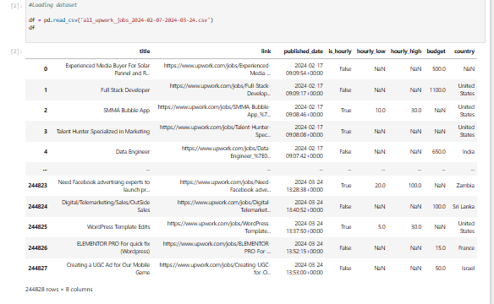
Data Exploration and Preparation
Load the datasets

Slide 5
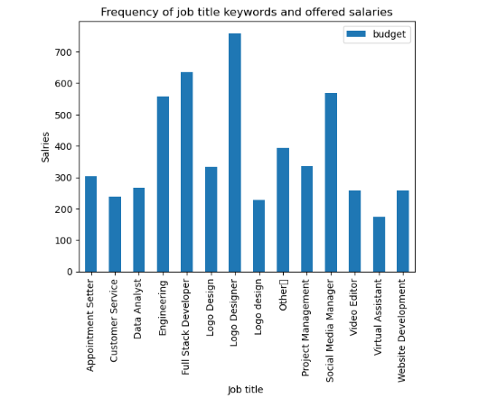
Data Exploration and Preparation
#Task 1: Analyze the correlation between job title keywords and offered salaries

Slide 6
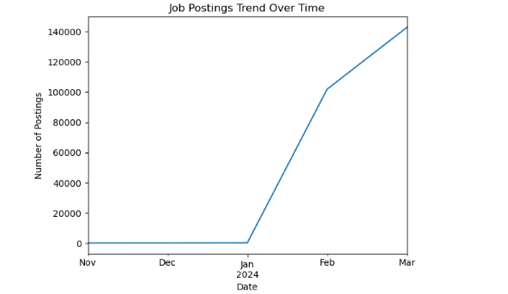
Data Exploration and Preparation
#Task 2: Identify emerging job categories based on posting frequency

Slide 7
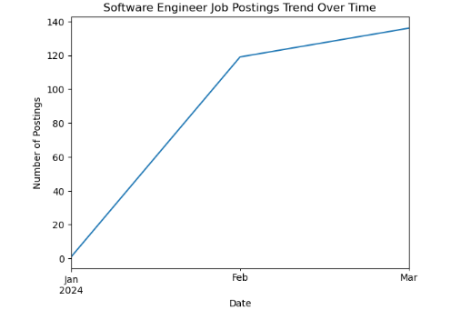
Data Exploration and Preparation
#Task 2: Identify emerging job categories based on posting frequency

Slide 8
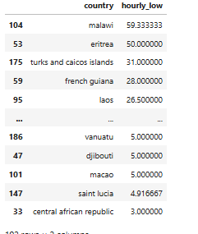
Data Exploration and Preparation
#Task 4: Compare average hourly rates across different countries

Slide 9
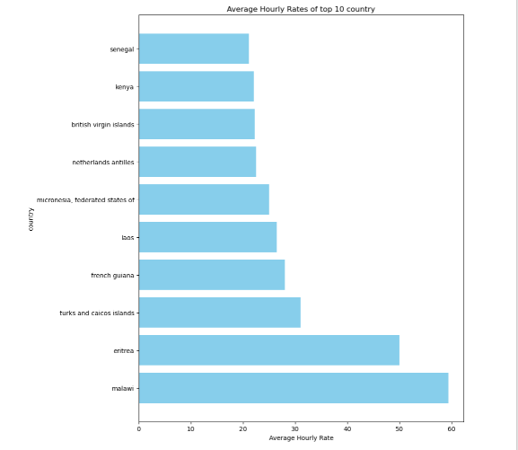
Data Exploration and Preparation
#Task 4: Compare average hourly rates across different countries

Slide 10
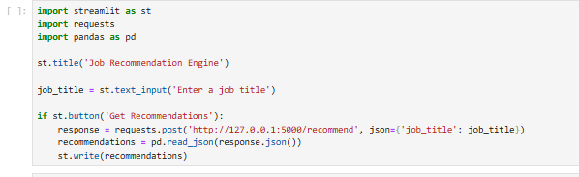
Feature Engineering and Model Selection
#Task 5: Create a job recommendation engine based on current job postings

Slide 11
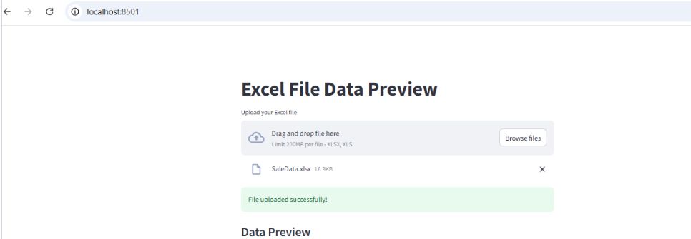
API Interface for interaction.

Slide 12
Thank you
Name - Navdeep Kohar
E-mail – navdeepkohark58@gmail.com
Ph - 9888339255

